Slide 1
Module 4: Kinetic and Thermodynamic Modeling

Slide 2

Outline
Part 1: Building kinetic and thermodynamic models
Fundamental aspects of reaction kinetics
Reaction thermodynamics
Dynamic simulation
Part 2: Enzyme kinetics
How to represent enzyme reaction mechanisms with mass action
Obtaining kinetic parameters for enzyme kinetic models
Practical application of kinetic modeling to data analysis
Zack Haiman
PhD Student
MASSpy Developer

Slide 3
Part 1: Building kinetic and thermodynamic models

Slide 4
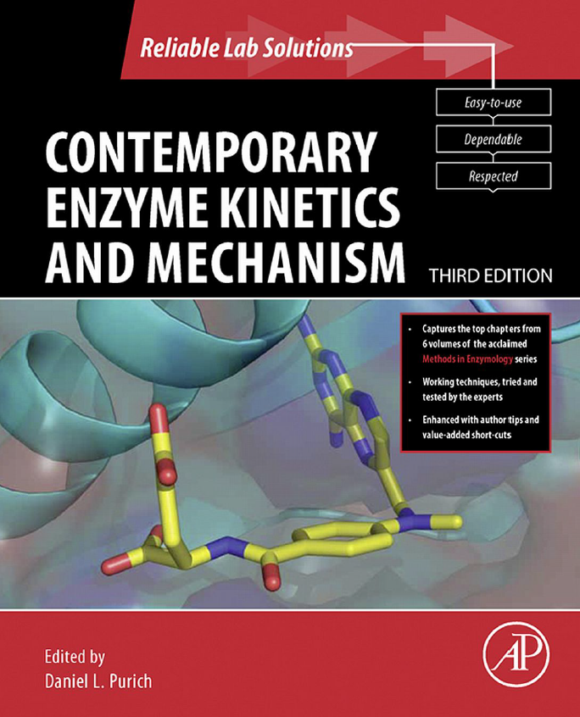
‘One-stop Shop’ Resource for Enzyme Kinetics
Chapters available through UCSD subscription

Slide 5
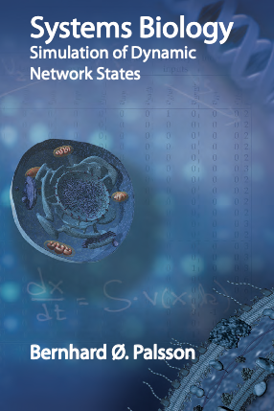
Systems Biology II: Simulation of Dynamic Network States

Slide 6
Dynamic Mass Balances
Formulation of dynamic networks

Slide 7
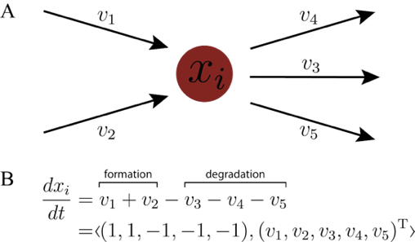
Mass Balance Equations

Slide 8
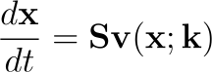
Formulation of Dynamic Networks
Dynamic Mass Balance
S: Stoichiometric Matrix
v: Fluxes
x: Concentrations
k: Kinetic constants
Dimensionless
(mol/mol)
Mass (or moles) per volume per time
Mass (or moles) per volume
1/time, or
1/(time*conc)
Examples: 1 mol ATP / 1 mol glucose
mM/hr
µM/s
mM
µM
s⁻¹
s⁻¹µM⁻¹

Slide 9
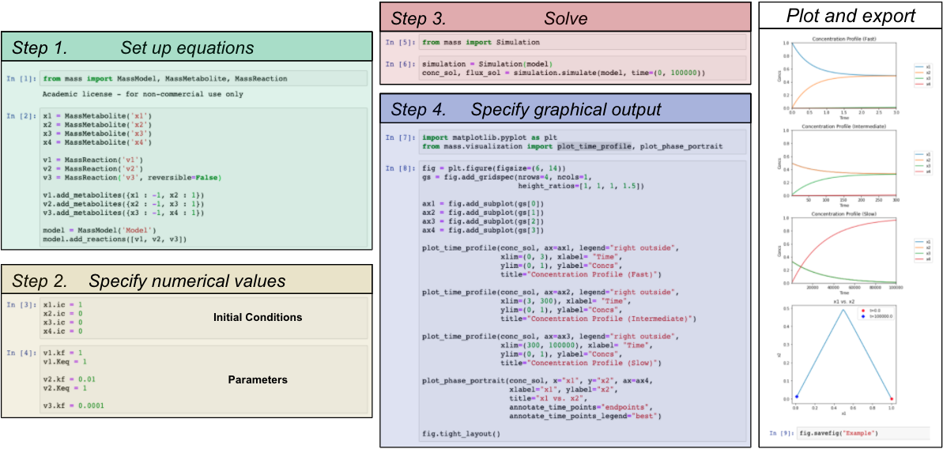
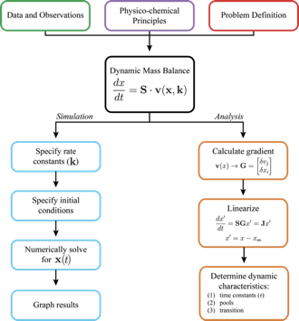
Formulation of Dynamic Networks
We will focus primarily on simulation

Slide 10
Key Assumptions
Continuum Assumption
Treat as a continuous medium rather than as individual molecules
Constant Volume Assumption
Ignore certain physico-chemical factors
e.g., Electroneutrality, osmotic pressure
Finer spatial structure of cells and organelles is ignored
Medium is homogeneous at ~100 nm
Constant temperature and pressure (isothermal, isobaric)

Slide 11
Chemical Kinetics
Introduction to rate laws and mass action kinetics

Slide 12
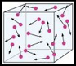
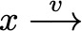
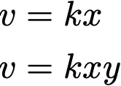
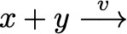
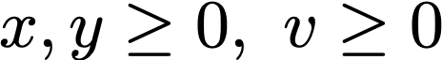
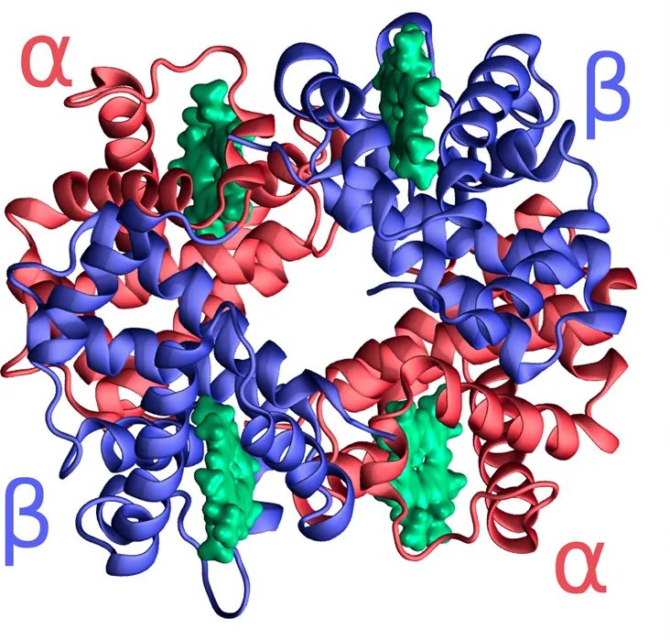
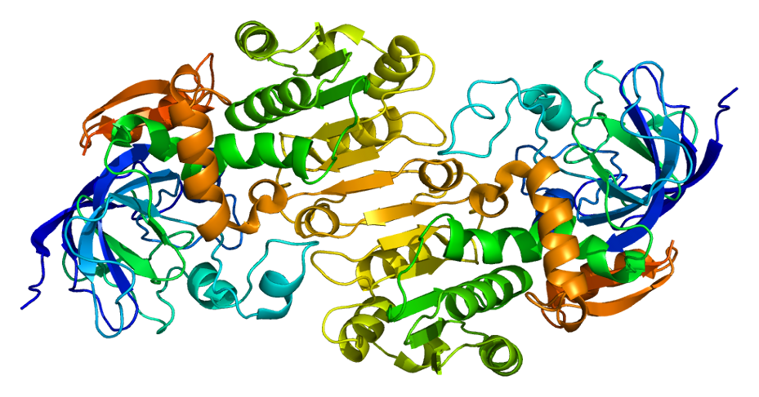
Kinetics and Rate Laws
( )
( )
Mass Action Kinetics:
rate of
reaction
Collision
frequency
𝞪
Two types of elementary reactions
Rate laws
Continuum
Assumption
Concentrations and fluxes are non-negative quantities
Linear:
Bilinear:
Example: Hemoglobin
Special Case: Dimerization
Example: Alcohol Dehydrogenase
Stoichiometric coefficient: 2
Lumped:
2𝛼 + 2𝛽 𝛼₂𝛽₂
Actual:
𝜒 + 𝜒 𝜒₂
𝛼 + 𝛽
𝛼𝛽
𝛼₂𝛽₂
𝛼 + 𝛽
𝛼𝛽

Slide 13
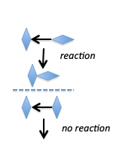
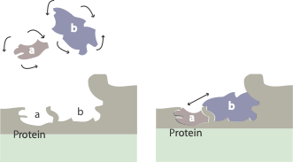

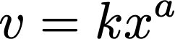
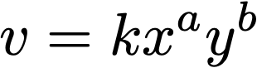
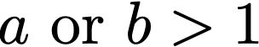
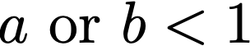
Kinetic Constants
Kinetic constants are biological design variables
Angle of Collision
Restricted Geometry*
Linear:
Bilinear:
Effect on collision frequency:
Hampered:
Favorable:
*rarely used
Numerical values determined by the frequency of the “right” collision
Enzymes are templates for the “right” collision
k is a biologically determined variable
Genetic basis, evolutionary origin

Slide 14
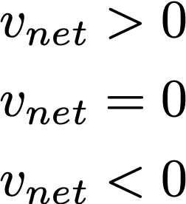
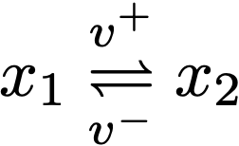
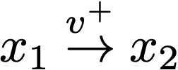
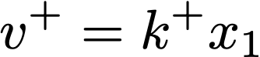
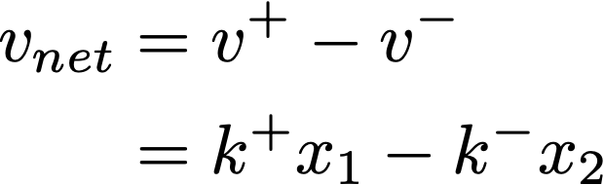
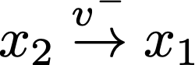
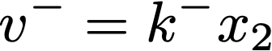
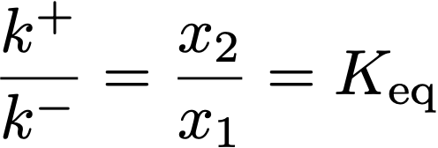
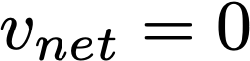
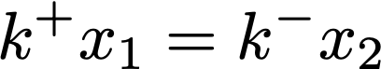
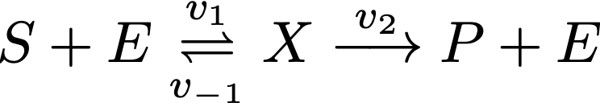
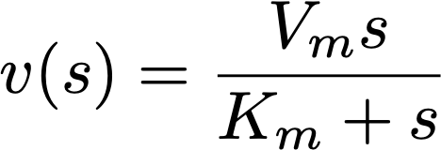
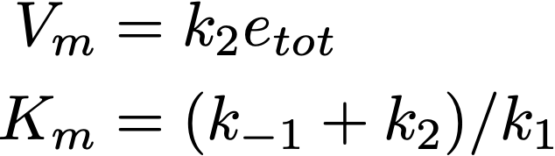
Combining Elementary Reactions
Reversible reactions:
Forward
Equilibrium
Reverse
Equilibrium constant is a physicochemical quantity
@Equilibrium:
determined via thermodynamics
Convert a reaction mechanism into a rate law:
Example: Michaelis Menten
QSSA or QEA
mechanism
assumption
rate law

Slide 15
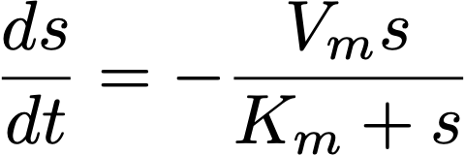
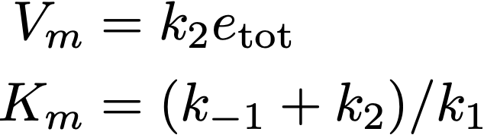
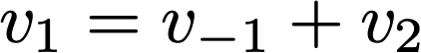
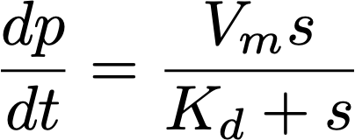
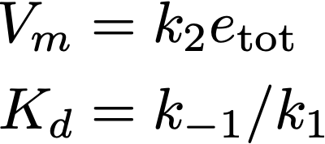
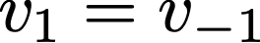
Simplifying assumptions as flux balances
The Quasi-steady state assumption (node)
QSSA
mechanism
assumption
rate law
QSSA: Flux balance on X;
The Quasi-equilibrium assumption (link)
QEA
mechanism
assumption
QEA: Flux balance;
rate law

Slide 16
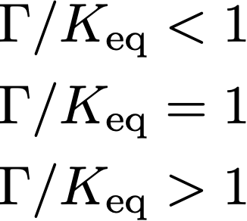
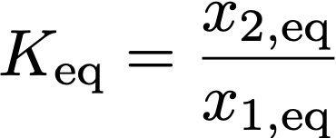
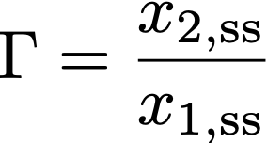
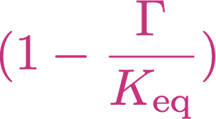
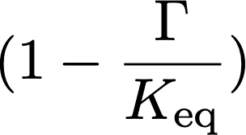
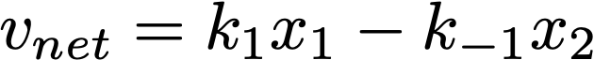
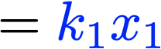
Distance from “equilibrium”
Reversible reactions:
Forward
Equilibrium
Reverse
Mass action ratio (𝚪):
Forward
Open
Closed System
Open System
Equilibrium
Reverse
Distance from equilibrium:
an aggregate variable or “pool”
speed of reaction
distance from equilibrium
= 0 at equilibrium

Slide 17
Reaction thermodynamics
What thermodynamic relations are important in metabolism?

Slide 18
Thermodynamics basics
Reactions proceed in a direction determined by thermodynamics
vΔ_{r}G < 0
i.e.
for v > 0, Δ_{r}G < 0
for v < 0, Δ_{r}G > 0

Slide 19
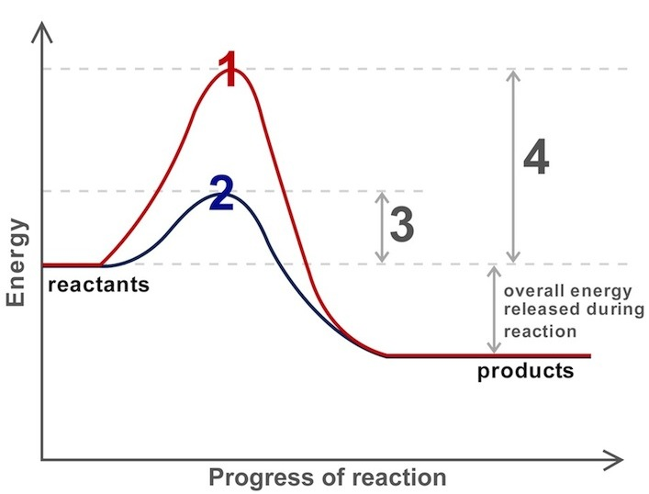
Reaction coordinate diagram
Before, we looked at kinetics and focused on the transition state activation energy
Now, we only care about the reaction energy, the difference between energy of reactants and products
http://www.sciencemusicvideos.com/wp-content/uploads/2014/10/

Slide 20
Gibbs Free Energy
Definition: Work performed by a system at constant pressure and temperature
First Law
Gibbs Definition
U = TS - pV + 𝜇N
G = U + pV - TS
dU = TdS + SdT - pdV - Vdp + 𝜇dN + Nd𝜇
dG = dU + pdV + Vdp - TdS - SdT
dT = 0
dp = 0
d𝜇 = 0
dT = 0
dp = 0
dG = dU + pdV - TdS
dU = TdS - pdV + 𝜇dN
dG = 𝜇dN
Reaction favorability comes down to the chemical potential of the reactants

Slide 21
Chemical Potential
Chemical potential: Gibbs energy gained from adding more molecule to the system
𝜇 = (∂G/dN)_{T,P,N}
𝜇 = 𝜇⁰ + RT ln (x)
𝜇⁰: Chemical potential under standard conditions
𝜇⁰ is a parameter, i.e. measured/estimated

Slide 22
Relating G to x
ΔG = ΔG⁰ + RTln(Q)
ΔG⁰ = -RTln(K_{eq})
Q: Reaction quotient
Q = Π(x^{S})
K_{eq}: Equilibrium constant
K_{eq} = Q_{eq}
ΔG = RTln(Q/K_{eq})
Reaction favorability depends on the ratio of the reaction quotient to the equilibrium constant

Slide 23
An example reaction
A ↔ B
ΔG = RTln(Q/K_{eq})
Q = Π(x^{S}) = A⁻¹ * B¹ = B/A
Assume K_{eq} = 2 (unitless)
Therefore K_{eq} = Q_{eq} = B_{eq}/A_{eq} = 2
B = 2A when the reaction is at equilibrium
When B < 2A, Q/K_{eq} < 1, ΔG < 0 → v > 0
When B > 2A, Q/K_{eq} > 1, ΔG > 0 → v < 0

Slide 24
Thermodynamics and kinetics
A ↔ B
v1
K_{eq} = B_{eq}/A_{eq}
For MA:
v1⁺ = k₁⁺A
v1⁻ = k₁⁻B
At Eq: v1⁺ = v1⁻
k₁⁺A_{eq} = k₁⁻B_{eq}
K_{eq} = B_{eq}/A_{eq} = k₁⁺/k₁⁻
Thermodynamics fundamentally tied to kinetics

Slide 25
Haldane relationship
v1
v2
A ↔ B ↔ C
First Law: ‘Overall’ K_{eq} = K_{eq,1}*K_{eq,2}
K_{eq,1} = k₁⁺/k₁⁻
K_{eq,2} = k₂⁺/k₂⁻
K_{eq,overall}= (k₁⁺k₂⁺)/(k₁⁻k₂⁻)
Total pathway must conserve energy

Slide 26
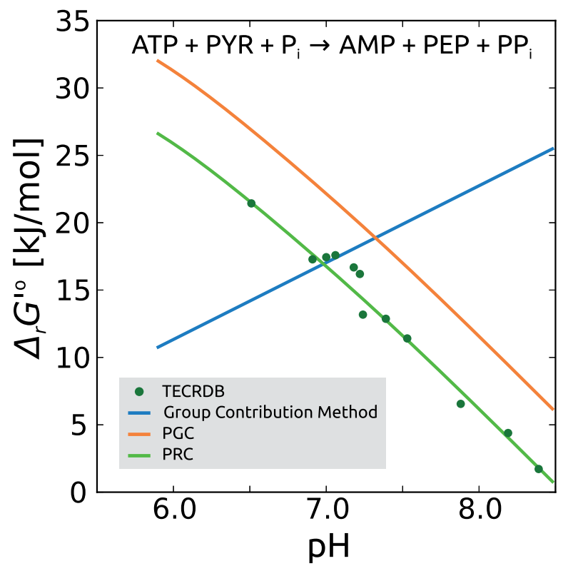
K_{eq} is sensitive to conditions
pH affects mets with proton binding groups (weak acids/bases)
Ions (esp. Mg) can complex with mets to change effective conc.
T also shifts K_{eq} (dG = dH-TdS)
https://www.ncbi.nlm.nih.gov/pubmed/22645166

Slide 27
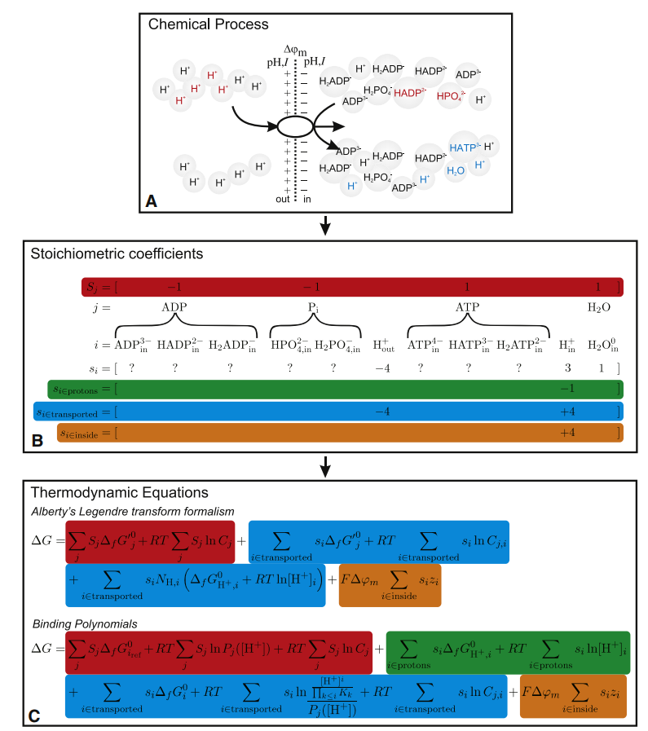
Transport thermodynamics can become complex
Base K_{eq}= 1 for transport (no chemical transformation)
However, must account for:
Coupled reactions (active transport)
Compartment-specific pH differences
Membrane potential
https://www.ncbi.nlm.nih.gov/pmc/articles/PMC2980713/pdf/main.pdf

Slide 28
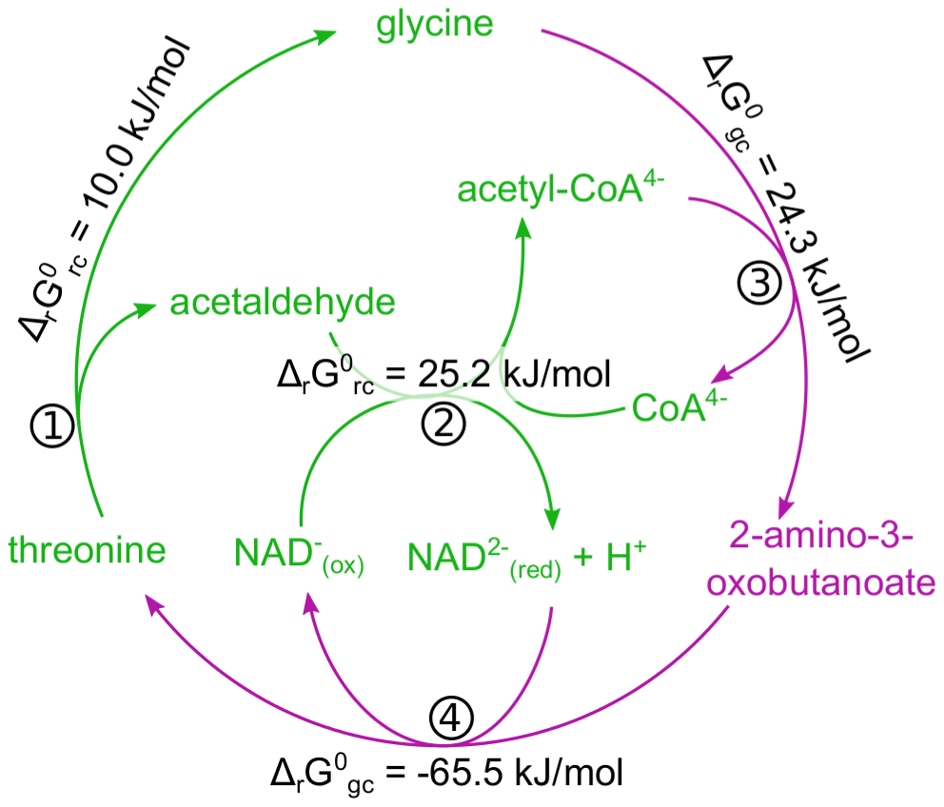
Estimating K_{eq}s: Reactant contribution
Measure some K_{eq} with metabolomics
Form reaction cycles to calculate others based on the First Law
http://journals.plos.org/ploscompbiol/article?id=10.1371/journal.pcbi.1003098

Slide 29
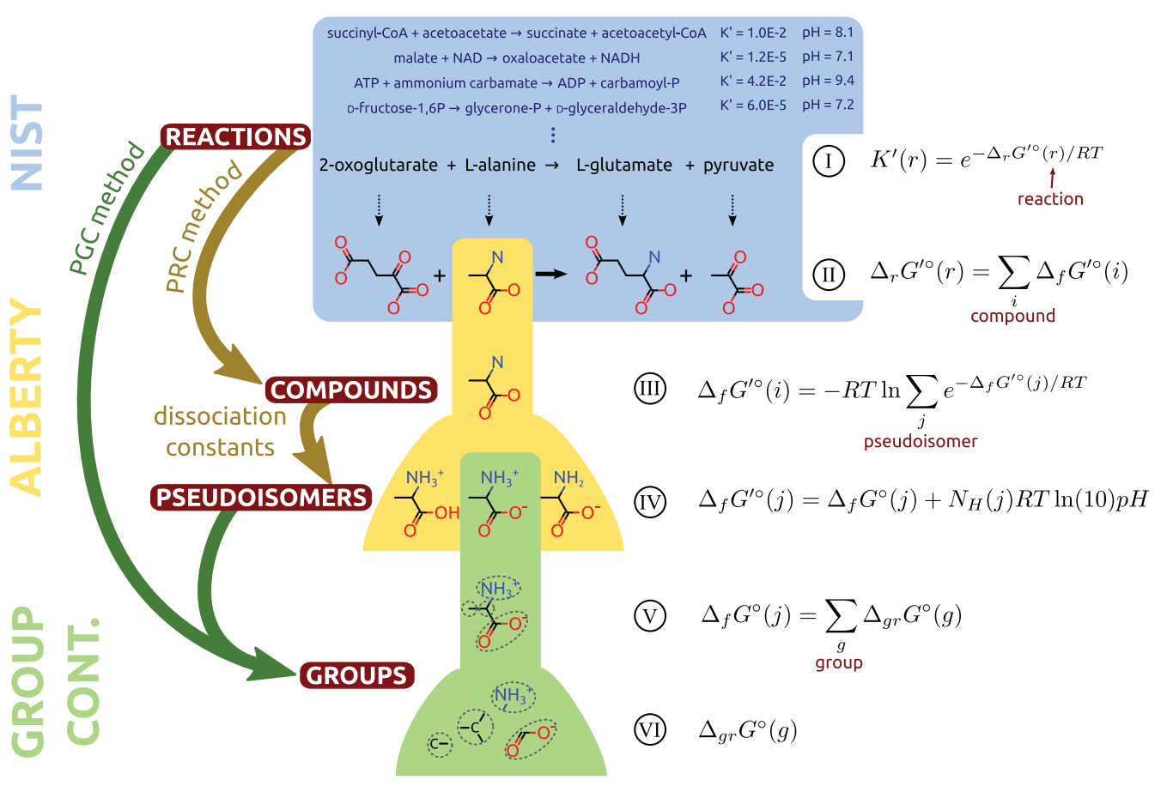
Estimating K_{eq}s: Group contribution
Break mets into chemical ‘groups’
Estimate energies with regression
https://www.ncbi.nlm.nih.gov/pubmed/22645166

Slide 30
Fundamental Kinetic Concepts
The basics of dynamic analysis

Slide 31

The Multi-scale Nature of Biology
Moran, Uri, et al. “SnapShot: Key Numbers in Biology.” Cell, Cell Press, 24 June 2010, www.sciencedirect.com/science/article/pii/S0092867410006732?via%3Dihub.
Notes:
https://www.sciencedirect.com/science/article/pii/S0092867410006732?via%3Dihub

Slide 32






Fundamental Concepts
Time Constants
Measures of characteristic time periods
Aggregate variables:
‘Pooling’ variables as time constants relax
Transitions
The trajectories from one state to the next
Graphical Visualization
Visualizing the data
log(x(t))

Slide 33


Time Constants
Time Constants:
A measure of the time it takes to observe a significant change in a variable or process of interest
Examples:
Milo, Ron, and Ron Philips. “" What Is the Turnover Time of Metabolites?” Cell Biology by the Numbers What Is the Turnover Time of Metabolites Comments, book.bionumbers.org/what-is-the-turnover-time-of-metabolites-and-trnas/.
Notes:
http://book.bionumbers.org/what-is-the-turnover-time-of-metabolites-and-trnas/

Slide 34


Aggregate Variables
Jamshidi, Neema, and Bernhard Ø Palsson. “Formulating Genome‐Scale Kinetic Models in the Post‐Genome Era.” Molecular Systems Biology, John Wiley & Sons, Ltd, 4 Mar. 2008, www.embopress.org/doi/full/10.1038/msb.2008.8.
Multiple time scales lead to aggregate variables

Slide 35
State Transitions

Slide 36


Graphical Visualization

Slide 37
Dynamic Simulation
Simulating the model and interpreting the responses

Slide 38


Simulation: 50% increase in k_{ATPM}
Dynamic responses of the concentrations
Key Concepts:
Time constants
Pools,
Transitions
Response to an increased k_{ATPM} parameter by 50%:
Reflects a change in the rate of usage of ATP
Simulate response to new steady state
3 times scales of interest: <1 hr, ~10 hr, ~50 hr
Fast (mins)
Intermediate (hours)
Slow (days)
2
2
2
ATP
Glu
Glu
Glu
ATP
ATP
1
1
1
ADP
ADP
ADP
AMP
AMP
AMP
0
0
0
0
Time
0.1
0
Time
10
0
Time
50

Slide 39


Tiled Phase Portraits: fluxes
Glycolysis: 0 - 10 hrs
Glycolysis: > 10 hrs
Mirrored Phase Portraits
Fluxes of interest
Fluxes of interest
HK
PGI
PFK
ALD
TPI
GAPDH
PGK
PGLM
ENO
PK
LDH
DM_{AMP}
APK
EX_{PYR}
EX_{LAC}
ATPM
DM_{NADH}
GLU_{in}
AMP_{in}
HK
PGI
PFK
ALD
TPI
GAPDH
PGK
PGLM
ENO
PK
LDH
DM_{AMP}
APK
EX_{PYR}
EX_{LAC}
ATPM
DM_{NADH}
GLU_{in}
AMP_{in}
HK
PGI
PFK
ALD
TPI
GAPDH
PGK
PGLM
ENO
PK
LDH
DM_{AMP}
APK
EX_{PYR}
EX_{LAC}
ATPM
DM_{NADH}
GLU_{in}
AMP_{in}
HK
PGI
PFK
ALD
TPI
GAPDH
PGK
PGLM
ENO
PK
LDH
DM_{AMP}
APK
EX_{PYR}
EX_{LAC}
ATPM
DM_{NADH}
GLU_{in}
AMP_{in}

Slide 40


















Dynamic Responses of the Fluxes
Flux
t = 0+
t = 50
Time Profiles of Fluxes
Key Phase Portraits
0.08
3.6
3.0
2.4
initial perturbation
0.00
1.8
10⁻³
10⁰
10³
1.8
3.4
0.30
Time
0.30
0.30
0.15
0.00
initial
perturbation
10⁻³
10⁰
10³
Time
0.18
0.18
0.00
0.08
1.8
3.4

Slide 41
Dynamic Responses of the Fluxes
0.08
0.30
0.30
High dynamic dimension
initial
perturbation
initial perturbation
0.18
0.18
0.00
1.8
3.4
1.8
3.4
0.00
0.08
2.2
0.24
2.4
Low dynamic dimension
1.6
0.17
0.17
1.7
2.4
1.6
2.2
0.9
1.2

Slide 42


Tiled Phase Portraits: concentrations
Glycolysis: 0 - 10 hrs
Glycolysis: > 10 hrs
Mirrored Phase Portraits
Glu
G6P
F6P
FDP
DHAP
GAP
PG13
PG3
PG2
PEP
PYR
LAC
NAD
NADH
AMP
ADP
ATP
P_{i}
Glu
G6P
F6P
FDP
DHAP
GAP
PG13
PG3
PG2
PEP
PYR
LAC
NAD
NADH
AMP
ADP
ATP
P_{i}
Glu
G6P
F6P
FDP
DHAP
GAP
PG13
PG3
PG2
PEP
PYR
LAC
NAD
NADH
AMP
ADP
ATP
P_{i}
Glu
G6P
F6P
FDP
DHAP
GAP
PG13
PG3
PG2
PEP
PYR
LAC
NAD
NADH
AMP
ADP
ATP
P_{i}

Slide 43
Graphical Representation
Visualization and interpretation of results

Slide 44


Time Profiles
Time profile of the solution x(t)
Multi-timescale representation
Segmenting the x-axis
𝝉₁
𝝉₂
𝝉₃
seconds
minutes
hours

Slide 45











Dynamic Phase Portraits
Characteristic “Signatures”
Shift to
new state
Can also plot fluxes v_{i}(t) and pools p_{i}(t) in the same way
increasing
perturbation
A very useful representation of results

Slide 46









Tiling Phase Portraits
A series of tiled phase portraits can be prepared
for each time scale of interest
Convey different information in corresponding tiles
Graphs
Statistics

Slide 47











Post-processing the Solution
1. Computing fluxes
2. Forming “pools”
3. Computing auto correlations
Example #1:
stst
n = 3, first segment
Time profiles
Example #2:
n = m, entire range
n = m, off-set in time, 𝝉 = 2
Phase portraits

Slide 48
Multi-scale representation
An example of representing multiple time-scales

Slide 49



























Example of Time-Scale Decomposition
System:
Fast
Intermediate
Slow
All times
Initial Conditions

Slide 50




















Example of Time-Scale Decomposition
System:
Fast
Intermediate
Slow
All times
Fast
Intermediate
Slow
Perfect correlation
expanded scale

Slide 51









Example of Time-Scale Decomposition
System:
Fast
Intermediate
Slow
All times
derived from correlations
dynamically independent pools
→ look for L-shape!

Slide 52

The Steady State
Finding the homeostatic reference state

Slide 53




The Glycolytic System
3 pathways
2 conservation
Knowing 3 fluxes i.e., - glucose uptake,
- AMP turnover,
- redox load
→ can compute the flux vector

Slide 54


Node Maps

Slide 55

Pathways in Null(S)
Selected basis based on biochemical intuition

Slide 56



Steady State Fluxes
0
1
2
Upper glycolysis
1.12
Lower glycolysis
2 * 1.12 = 2.24
Steady state fluxes (mM / hr)
AMP
Exchange and
demand fluxes

Slide 57


Steady State Concentrations
0
1
2
Kinetic constants can be determined from the flux map and the concentrations
Steady state concentrations (mM)

Slide 58


Explaining the calculation of pseudo elementary rate constants (PERCs)
Reaction: A + B → C + D
Rate: v_{ss} = k_{PERC} ( A_{ss}* B_{ss} - C_{ss}* D_{ss}/K_{eq})
COBRA/Fluxomics
Metabolomics
Thermodynamics
Only k_{PERC} is unknown → compute k_{PERC}

Slide 59
Basic Kinetic Modeling Procedure
The workflow for performing dynamic simulations

Slide 60






Dynamic Simulation
Formulate the dynamic mass balances:
Specify numerical values for parameters (k) and initial conditions (x₀):
Integrate ODEs to obtain the numerical solution
Run a software package
MASSpy
Analyze the results
Graphically:
Post-processing
t
t

Slide 61

MASSpy
Mass Action Stoichiometric Simulation in Python 3.6+
Dynamic simulation software package built on COBRApy framework
MASSpy resources:
Package and distribution:
https://pypi.org/project/masspy/
https://github.com/SBRG/MASSpy
Documentation:
https://masspy.readthedocs.io/en/latest/#
Systems Biology: Simulation of Dynamic States (SB2):
https://masspy.readthedocs.io/en/latest/sb2_textbook.html
Haiman et. al, MASSpy: Building, simulating, and visualizing dynamic biological models in Python using mass action kinetics
Manuscript in preparation

Slide 62




Typical Workbook
Solve
Step 3.
Plot and export
Set up equations
Step 1.
Step 4.
Specify graphical output
Step 2.
Specify numerical values
Initial Conditions
Parameters

Slide 63
Simulation Results
A table of numbers
Can correlate variables, r²
Off-set in time
On a particular time scale

Slide 64
Part 2: Enzyme Kinetics

Slide 65
Enzyme Kinetics
A review of classic models of enzyme kinetics

Slide 66


A Review of Enzymes
Reaction activation Energy
Catalysis Basics
Enzymes increase rates of reactions by lowering the activation energy.
The surface has ‘information’ about the reactants and …
… the ‘right’ angle for the reaction to take place

Slide 67


A Review of Enzymes
Linear reaction
Koolman, J. and Roehm, K.H., Color Atlas of Biochemistry, 2nd Ed., Thieme, New York, 2004.

Slide 68


Enzyme Mechanisms
Various descriptions of enzyme mechanisms
Mechanism complexity elucidated over time as discoveries lead to better understanding of enzyme behavior.
Mechanism and simplifying assumption determine rate law
Ex: Bi-substrate enzyme mechanisms
Ulusu, N.N. Evolution of Enzyme Kinetic Mechanisms. J Mol Evol 80, 251–257 (2015). https://doi.org/10.1007/s00239-015-9681-0
Notes:
https://link.springer.com/article/10.1007/s00239-015-9681-0#Fig1

Slide 69
Deriving Enzymatic Rate Laws
Formulate dynamic mass balances on elementary reactions
Identify time invariants (Left null space)
Reduce dynamic description to dynamically independent variables
Applying simplifying assumptions:
Quasi-steady-state assumption (QSSA) or Quasi-equilibrium assumption (QEA) to reduce number of independent variables
Use numerical integration to determine when the assumptions apply
Scale equations and form dimensionless numbers (optional; advanced)

Slide 70










Michaelis-Menten Kinetics
1. Reaction mechanism
2. Equations
Rate laws
Dynamic mass balances
Fast
Slow
Mass conservation
(Dynamic degrees of freedom)
m - r = 4 - 2 = 2 time invariants

Slide 71













Michaelis-Menten Kinetics
3. Simplifying assumption
4. Reaction rate
Independent Variables:
QSSA
The Famous MM-equation

Slide 72











Applicability of Assumptions
QSSA: Flux balance on X;
Quasi-Steady-State Assumption (QSSA)
QEA: Flux balance;
or
Quasi-Equilibrium Assumption (QEA)

Slide 73




Hill Kinetics
1. Reaction mechanism
2. Equations
Rate laws
Inhibited enzyme
Dynamic mass balances
Hill Coefficient (𝞶):
“degree of cooperativity”
Lumping effect of (2) → rarely an integer
e.g., 𝞶_{Hb} ~ 2.3 - 2.6
Mass conservation

Slide 74













Hill Kinetics
3. Simplifying assumption
4. Reaction rate
QEA
activation
Acceleration factor (𝜶)
Mass Conservation
inhibition
Hill Equation

Slide 75














Modelling Cooperativity
Monod-Wyman-Changeux (MWC) model
1. Reaction mechanism
2. Equations
A realistic model of allostery and cooperativity
Rate laws
General
Dynamic mass balances
Mass conservation
Tetramer (𝜈 = 4)

Slide 76


















Symmetry Model
Monod-Wyman-Changeux (MWC) model
3. Simplifying assumption
QEA
General
Mass Conservation
x = Le
Symmetry rate law
Tetramer (𝜈 = 4)

Slide 77


Enzyme Modules
Enzyme Modules: full stoichiometric description of ALL elementary binding reaction steps for an enzymatic mechanism
Catalytic mechanism for each catalytic site
Regulatory mechanisms (activation, inhibition, allostery and cooperativity, etc.)
Yurkovich JT, Alcantar MA, Haiman ZB, Palsson BO (2018) Network-level allosteric effects are elucidated by detailing how ligand-binding events modulate utilization of catalytic potentials. PLOS Computational Biology 14(8): e1006356.

Slide 78



Modeling condition effects on enzyme kinetics
pH effects on enzyme activity
Model the ‘critical’ (de)-protonation reactions on the enzyme
Temperature effects on rate constants
Transition state theory

Slide 79
Phosphofructokinase
Catalytic properties, regulation and structural biology of the enzyme

Slide 80




Metabolic Role of PFK
Exists as a tetramer
3 isoforms: Muscle (M), Liver, (L), Platelet (P)
Two natural conformations: R, T (relaxed, tight)
AMP
ATP
PFK-P tetramer
PDB ID 4XYK
‘Tug of war’
Known inhibitors: ATP, citrate, PEP
Known activators AMP, cAMP, Pi, FDP
Catalytic Activity:

Slide 81




Structure of the PFK-P (Platelet Isoform)
PFK-P (Platelet Isoform)
Other two isoforms include muscle (M) and liver (L)
Recently solved structure, along with muscle isoform (2015)
PFK-P homotetramer
Catalytic and allosteric sites Highlighted
Yurkovich et al, 2019, PLOS Comp. Bio
Substantial conformational changes in structure upon ATP hydrolysis
Found mechanistic explanations for cancer mutations within PFK
catalytic interface:
tetramer interface:
Left: Location of PFK-P mutations in cancers
Middle: Structural overlap of ATP-Mg²⁺bound and ADP-bound tetramers
Right: Conformation of the active site in the ATP-Mg²⁺bound and ADP-bound structures

Slide 82





The PFK sub-network
Catalytic Mechanism: Ordered Sequential Bi-bi
Regulation:
Activation via AMP:
Conformation:
Inhibition via ATP:

Slide 83

Annotated Stoichiometric Matrix
Input/Output
Activation and Catalysis
Inhibition
Exchange Reactions
Catalytic and activating reactions
Conformation reaction
Inhibiting reactions
Parallelized pathways

Slide 84

Pathways
p₁
p₂
p₃
p₄
p₅

Slide 85



Defining Pools and Ratios
PFK - Relaxed (R) state
All forms of R:
PFK - Tense (T) state
All forms of T:
PFK - R catalytic state
All forms of R_{i, AF}:
Ratios
Looking ahead; at steady state

Slide 86
Classical experiments in Enzyme Kinetics
How does kinetic information help in data analysis?

Slide 87

Progress Curves
Isolate an enzyme, add substrate, and monitor progress
Coupled assay or sampling
Challenge: Curve is non-linear, not simple to fit (in the old days)
Product accumulates

Slide 88

Initial Rate experiment
What if we only look at the rate at the start, while product ~ 0?
Measure initial rate (v_{ss}) at different starting substrate (or effector or media) concentrations
Does this simplify the analysis?

Slide 89


Lineweaver-Burk Plot
Inverse reciprocal plot (1/v vs 1/x) linearizes the MM rate law
Can determine Km and kcat from the slope and intercept
Not the most numerically sound for noisy data

Slide 90


Identifying inhibition schemes
Shifts to slope and intercept inform how an inhibitor works
Competitive inhibitor: Binds the same site as the substrate
Affects K_{m}, not V_{max}
Noncompetitive inhibitor: Binds a different site as the substrate
Affects V_{max}, not K_{m}

Slide 91


Measuring microscopic parameters
Normally, steady-state is rapidly reached in solution
Stopped flow experiments can measure pre-steady state kinetics
Inject reactant into a mixer, then stop the flow
Monitor the progress (i.e. with fluorescence)

Slide 92
MASSef: A rate constant fitting toolbox
How can we find rate constants that match the enzyme kinetic data?

Slide 93
Macroscopic vs Microscopic Parameters
Microscopic: Rate constants of individual reaction steps (k⁺,k⁻)
Macroscopic: Parameters observable through experiment (K_{m}, k_{cat})
Appear in Michaelis-Menten-type rate laws
Macroscopic parameters can often be derived in terms of microsopic parameters
These expressions get complicated for large enzyme mechanisms

Slide 94
The parameterization challenge
Mass action models are flexible and mathematically nice
However, we need microscopic rate constants, which are hard to measure
Unlikely that are system will be fully specified (data < parameters)
How to deal with uncertainty in parameters, while still constraining behavior based on what we know?

Slide 95

MASSef overview
Mathematica workflow to 1) Build enzyme modules and 2) Find k
Uses MASS toolbox
5 steps
Import data
Define a mechanism
Generate functions to compare data to model
Fit k using regression
Evaluate results

Slide 96


Step 1: Import data
Curated enzyme data
Sources
BRENDA
Uniprot
Literature
NIST (K_{eq})
Mostly steady-state data
K_{M}, k_{cat}, K_{i}, K_{eq}, n
Imported automatically
Condition corrected (T, IS)

Slide 97


Step 2: Set up mass action mechanism
User defines the enzyme mechanism
MASS Toolbox generates a model object
Allosteric and inhibition schemes are automatically handled based on data

Slide 98

Step 3: Generate comparison equations
Derive equations from the mechanism to match to data
f(k,x) = y_{data}
e.g. v_{max,model}(k,x)/E = k_{cat,data}
Simulate data curves when necessary to match equation
e.g. a Michaelis-Menten curve to fit K_{M}

Slide 99


Solving the steady-state of a system
Steady-state solutions for species are often required to construct comparison equations (v_{ss})
King-Altman algorithm is classical approach
Based in determinants of reaction sub-pathways
Now, we just use computer algebra systems
Mathematica’s Solve function

Slide 100

Step 4: Fit rate constants
Objective: Find k to minimize SSD
(f(k,x)- y_{data})²
Challenges
f(k,x) is highly nonlinear
Hard to fit, no guarantee of global minimum
k spans many orders of magnitude
Performance difficult
Strategy: Use two-stage approach
1) PSO to find initial points
2) LMA to solve

Slide 101

Levenberg-Marquardt
Also known as Damped Least-Squares
Derivative-based optimization
Utilizes gradient descent
Damping parameter helps with ill-scaling
Can move faster in flat regions
Still, often can’t solve with bad starting points

Slide 102

Dealing with local solutions
Want random ‘decent’ starting points to find alternative solutions
Particle swarm optimization to find starting points for the LMA
Derivative-free optimization
PSO bad at refinement on its own

Slide 103
Step 5: Fit assessment
Goodness of fit
SSE, back-calculated macroscopic parameters
Clustering properties of alternative solutions
Can assess whether solutions were sampled sufficiently via convergence
Parameter uncertainty

Slide 104
Example: GAPD in Glycolysis
Mechanism
Fit Goodness
Data
Uncertainty
Clustering

Slide 105
Using kinetics to inform multi-omic data analysis
How does kinetic information help in data analysis?

Slide 106
How is v controlled by x and E?

Slide 107
How is flux controlled?
Knowledge: The rate law relates v to x and E
e.g. Michaelis Menten
Question: Does x or E exert more control on flux in vivo?
Do in vitro kinetic rate laws even represent how flux is controlled in vivo?
Study: 2016 Science paper from Rabinowitz lab on yeast across 25 growth conditions
5 substrates x 5 growth rates

Slide 108

http://science.sciencemag.org/content/sci/354/6311/aaf2786.full.pdf

Slide 109


Slide 110

PRPP aminotransferase

Slide 111

Discovering new regulation

Slide 112


Slide 113

Pyruvate Kinase

Slide 114


Slide 115

What determines reaction rate?

Slide 116


Slide 117
End

Slide 119
Extra Slides

Slide 120
Relationship between x and K_{m}

Slide 121

Relating x to Km
Knowledge: K_{m} acts like a binding constant
When x << K_{m}, enzyme is almost all unbound
When x >> K_{m}, enzyme is saturated
Question: What are the in vivo bound states of enzymes?
https://www.nature.com/articles/nchembio.186.pdf

Slide 122

Relating x to Km
2009 study from Josh Rabinowitz’s lab at Princeton
Quantitative metabolome of E. coli with LC-MS
https://www.nature.com/articles/nchembio.186.pdf

Slide 123

x ~ K_{m} for most mets
Cofactors
x >> K_{m}
Degradation reactions
x << K_{m}
https://www.nature.com/articles/nchembio.186.pdf

Slide 124
Summary of findings
in vivo x seems to be related to K_{m}
Most reactions are ~ half-max efficiency
Not entirely wasted protein
Not saturated (v insensitive to x)
Cofactors are more saturated
Used efficiently, reactions insensitive at substrate binding level
Motivates allosteric regulation?
Degradation reactions less saturated
Enzyme waits for unwanted metabolite to appear

Slide 125
Predicting allosteric regulation

Slide 126
Predicting allosteric regulation
Knowledge: Allosteric regulation should be key influencers of flux across conditions
Question: Do we see evidence of allosteric regulation in dynamic response that would allow use to predict new regulation?
Study: 2013 NBT paper from Sauer lab on E. coli under rapid perturbation between pyr, glc, and fruc growth

Slide 127

Modeling and measuring metabolism

Slide 128


Slide 129

Metabolites regulate flux reversal

Slide 130

Predicting new regulators
Pyruvate activation of FBPase

Slide 131


Slide 132
Summary of findings
Kinetic experiments can probe dynamic regulation of metabolism
Kinetic modeling can hypothesize new regulation to explain data
Validation of predicted allosteric regulation was successful

Slide 133
Flux Sensing

Slide 134
How is flux sensed?
Knowledge: The cell can sense metabolite levels through binding to enzymes and regulators, but really it would like to know its function (v)
Question: Can it use metabolite levels to indirectly sense flux (a rate) too?
Study: 2013 study by Matthias Heinemann at ETH Zurich in PNAS on E. coli

Slide 135

http://www.pnas.org/content/pnas/110/3/1130.full.pdf

Slide 136


Slide 137
Summary of findings
FBP concentration depends on input flux to glycolysis, acting as a flux sensor that regulates Cra
FBP feedforward activation of PYK leads to a linear response to pathway flux over a wide range of concentrations
Interconnected regulatory levels lead to desirable metabolic regulatory behavior

Slide 138
In vitro vs in vivo data - k_{cat}

Slide 139
In vivo k_{cat}s
Knowledge: We can measure maximal rates for enzymes in vitro, defining their turnover constants (k_{cat}) under artificial conditions
Question: Are in vivo k_{cat}s similar to in vitro estimates?
Study: Ron Milo’s lab study of BRENDA data from 2016

Slide 140
Basis for in vitro-in vivo differences
pH (optima, experimentally selected, etc)
T - Arrhenius law
buffer
protein interactions
crowding
Many more...

Slide 141

In vivo k_{cat}s
http://www.pnas.org/content/113/12/3401

Slide 142

Generally good agreement between in vivo and in vitro k_{cat} values

Slide 143




Additional factors

Slide 144
Summary of findings
k_{cat} values can be estimated from in vivo v and E data
in vivo k_{cat} values agree surprisingly well with in vitro values
Saturation and thermodynamic factors can explain outliers

Slide 145
Explaining k_{cat} values

Slide 146
In vivo k_{cat}s
Knowledge: We know that some enzymes are fast while others are slow
Question: Can we understand the principles that determine k_{cat} values?

Slide 147

Constraints on k_{cat}
Diffusion limit
10⁹ s⁻¹ on/off rate
Haldane relationship
high k_{cat}⁺ requires loose binding or high k_{cat}⁻
Do k_{cat}s evolve to their optimal levels?

Slide 148

The ‘Moderately Efficient’ Enzyme

Slide 149


By Subsystem
https://pubs.acs.org/doi/abs/10.1021/bi2002289

Slide 150


Hypothesis: Insufficient evolution

Slide 151

A kcat evolution simulation
growth rate stalls
diminishing returns

Slide 152

Result: Halted evolution

Slide 153
Summary of findings
kcats are generally not evolved to theoretical optimal levels
Central metabolism is more highly evolved than peripheral metabolism
A selection-pressure based model explains kcat distributions based on the principle of diminishing returns

Slide 154
Evaluating the importance of the choice of rate law v = f(x)

Slide 155
Evaluating rate laws
Knowledge: The dependence of flux (v) on metabolic concentrations (x) is mechanism-dependent and is defined in the rate law v = f(x)
Question: In lack of full mechanistic knowledge, many rate law approximations have been proposed. Which approximations work best?

Slide 156

https://bmcsystbiol.biomedcentral.com/track/pdf/10.1186/s12918-016-0283-2

Slide 157



Slide 158


Slide 159


Time constants determine kinetics more so than rate laws

Slide 160
Summary of findings
Rate laws impact model fidelity less than expected
Rate law approximations likely share similar dynamic behavior regardless of parameters
Concentrations set pools that determine fast and slow responses regardless of rate law

Slide 161
Conclusions
Simple kinetic theory can inform data analysis
Especially useful for relating quantitative data on v, x, and E
Uses:
Discover principles of regulation of metabolism
Understand evolution of enzyme constants
Predict new regulatory events
One day - predictive cell modeling?

Slide 162
Network thermodynamics
How do we calculate thermodynamics at the network level?

Slide 163



Decomposing Michaelis-Menten
Use Haldane to decompose MM
1) Intrinsic speed (k_{cat})
2) Saturation (x/K_{m}) (~0-1)
3) Therm (1-Q/K_{eq}) (~0-1)
High efficiency
v ~ v_{max} = Ek_{cat}
https://www.sciencedirect.com/science/article/pii/S0014579313005577

Slide 164

Thermodynamic Efficiency
γ
Near equilibrium:
γ = 1-Q/K_{eq} ~ 0 v⁺ ~ v⁻
The reaction is thermodynamically inefficient
https://www.sciencedirect.com/science/article/pii/S0014579313005577

Slide 165


Network thermodynamics
Concentrations distribute to minimize v⁻
https://www.nature.com/articles/nchembio.2077.pdf

Slide 166



Efficiency at the network level
Glycolysis

Slide 167



Efficiency can influence pathway choice
Channeling may bypass thermodynamic efficiency constraints

Slide 168

Alternate Pathway Choice

Slide 169

Thermodynamics differ between pathway alternatives

Slide 170

E. coli chooses costly pathways

Slide 171

More Tradeoffs: EMP vs ED
Entner-Doudoroff pathway is a low yield alternative to glycolysis
Why does it exist?
http://www.pnas.org/content/pnas/110/24/10039.full.pdf

Slide 172


ED Prevalence
Proteobacteria see mixed EMP/ED and even sole ED pathway choice
http://www.pnas.org/content/pnas/110/24/10039.full.pdf

Slide 173



ED is proteome efficient
Substrate availability dictates pathway prevalence in genomes
http://www.pnas.org/content/pnas/110/24/10039.full.pdf

Slide 174


Uncovering regulation using thermodynamics
Observation: Irreversible enzymes are often allosterically regulated
https://www.ncbi.nlm.nih.gov/pmc/articles/PMC1681506/

Slide 175
Summary
Thermodynamics constrain the relationship between flux direction and reaction energy
Reaction energy depends on the natural favorability of the reaction (K_{eq}) and the current state of the system (x and the resulting reaction quotient Q)
Thermodynamics are fundamentally connected to kinetics through the mass action rate law
The Haldane relationship places constraints on connected reaction steps
The Michaelis-Menten equation can be broken down into terms:
1) Inherent efficiency (kcat)
2) Substrate efficiency (x/Km)
3) Inhibition state (x/Ki)
4) Thermodynamic efficiency (1-Q/K_{eq})
Thermodynamic principles can be used in optimization and data analysis to understand metabolic network organization

